Slide 1
Artificial Intelligence: Optimization models 1
Santosh GSK
Industry Expert- AI

Slide 2
Optimization Models
Goal: Navigate through a state space for a given problem such that an optimal solution can be found

Slide 3

Optimization Models
E.g., 8 queens problem
A feasible arrangement in the state space
Optimal Solution

Slide 4
Optimization Models
E.g., 8 queens problem
A feasible arrangement in the state space
A neighboring arrangement in the state space

Slide 5
Optimization Models – Fitness function
Fitness function (objective function) – evaluates the goodness of a solution
E.g., 8 queens problem
Fitness function: Number of pairs that are attacking
Fitness Value = 2

Slide 6
Optimization Models – State space landscape
Global maximum
Local maximum
YOU ARE HERE
Fitness
value
Local minimum
Global minimum
Feasible State Space

Slide 7
Optimization Models
Local search algorithms – Search in the state-space in the neighborhood of current position until an optimal solution is found
Hill Climbing Algorithm and its variants
Simulated Annealing
Local Beam Search
Population based algorithms – Instead of single instance in state-space, use multiple parallel instances (i.e., population) in finding the optimal solution
Genetic Algorithms
Particle Swarm Optimization
Ant Colony Optimization

Slide 8

Hill Climbing
Imagine climbing a hill with dense fog and you can see up to 20 mts
As you reach a top you might end your climb, assuming it is the top

Slide 9
Hill Climbing
Algorithm:
Continuously move in the direction of uphill (higher fitness value) by looking at neighborhood points
Terminate when it reaches a peak (where no neighbor has a higher value)
It does not look ahead beyond the immediate neighbors of current state
Also called Greedy Local Search

Slide 10
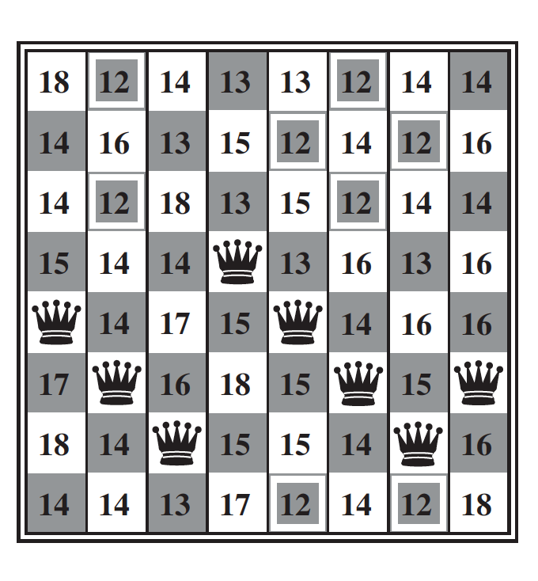
Hill Climbing
E.g., 8 queens problem, look for fitness values from neighborhood successors
Current Fitness Value = 17

Slide 11
Hill Climbing – Limitations
Local Optima – As it evaluates only neighbors, it has no move left when it reaches a local maxima/minima. This doesn’t ensure that the global optima is reached
Ridges – A special scenario of local optima where several local optima are found in a neighborhood making the algorithm hard to navigate.
Plateau – A flat surface on the fitness curve from which no uphill exists

Slide 12
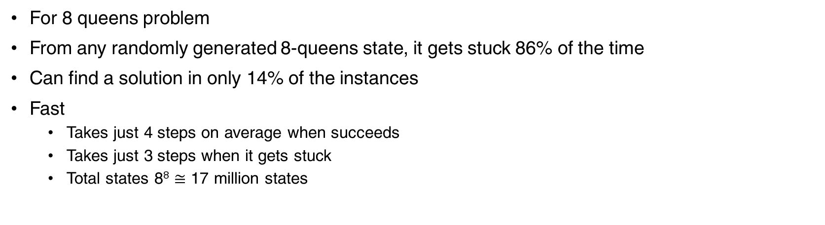
Hill Climbing
For 8 queens problem
From any randomly generated 8-queens state, it gets stuck 86% of the time
Can find a solution in only 14% of the instances
Fast
Takes just 4 steps on average when succeeds
Takes just 3 steps when it gets stuck
Total states 8⁸ $≅$ 17 million states

Slide 13
Stochastic hill climbing
Selects the next state randomly with a probability
Probability is a function of fitness value of the neighbor
Finds better solutions in the events where Hill Climbing gets stuck
Converges slower than Hill Climbing

Slide 14
First choice hill climbing
Improves over stochastic hill climbing
Implements stochastic hill climbing by
Generates successors randomly until a successor with higher fitness value is found
Useful when there are thousands of possible successors

Slide 15
Random Restart Hill Climbing
Whenever the hill climbing algorithm gets stuck, try again from a different initial state until the goal is reached
“If at first you don’t succeed, try, try again”

Slide 16
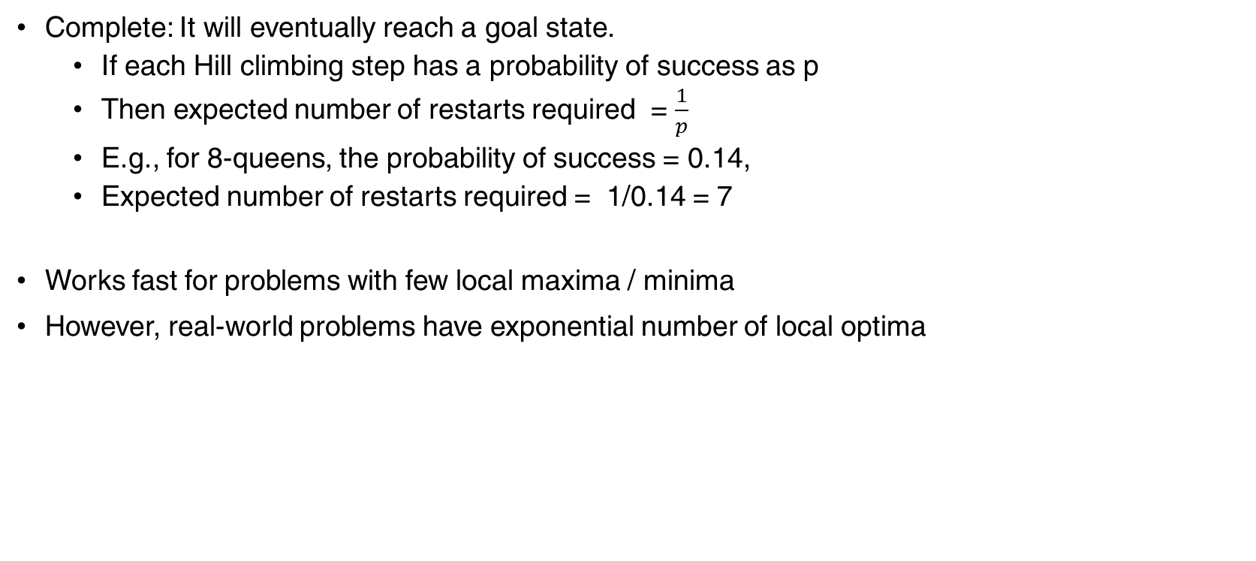
Random Restart Hill Climbing
Complete: It will eventually reach a goal state.
If each Hill climbing step has a probability of success as p
Then expected number of restarts required = $\frac{1}{p}$
E.g., for 8-queens, the probability of success = 0.14,
Expected number of restarts required = 1/0.14 = 7
Works fast for problems with few local maxima / minima
However, real-world problems have exponential number of local optima

Slide 17
Simulated Annealing
Annealing is a concept used in Metallurgy
Heating a metal to critical temperatures and then cooling down gradually
Results in a crystalline structure which is low-energy and tough.
Simulated annealing
Imagine a ball traversal on fitness function
When it reaches a minima
Shake it vigorously (high temp) to escape local minima
Slowly reduce the vigor (reduce the temp) with iterations

Slide 18
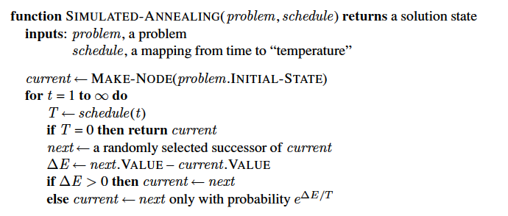
Simulated Annealing

Slide 19
Local Beam Search
In previous algos, keeping only 1 state at a time can be too limiting
Local Beam Search
Select ‘k’ random states
Evaluate the fitness value for all their successors
If anyone of the successors is a goal, the algorithm stops
Else, select the top ‘k’ from all the successors
Repeat from Step 2

Slide 20
Local Beam Search
Lack of diversity: Quickly can get concentrated into a small region
Can make it more expensive than hill climbing

Slide 21
Stochastic Beam Search
Analogous to stochastic hill climbing
Algorithm
Initialize with ‘k’ random states
Evaluate the fitness scores for all the successors of the k states
Calculate the probability of selecting a successor based on fitness score
Select the next ‘k’ states randomly based on the probability
Repeat from Step 2

Slide 22
Stochastic Beam Search
Similar to natural selection
Successors (offspring) of a state (parent) populate the next gen based on its value (fitness)

Slide 23
Genetic Algorithms
A variant of stochastic beam search
Stochastic Beam Search | Genetic Algorithms
Randomly selects ‘k’ initial states | Randomly selects ‘k’ initial states
Successors are generated from single parent’s neighborhood | Successors are generated by doing a crossover of two parents and mutation

Slide 24
Genetic Algorithms
Each state is represented as a stream of bits
E.g., for 8-queens problem, it can be a 8 bits of integers, each ranging form 1-8 indicating the position of queen within the column.
13864256

Slide 25
Genetic Algorithms
Start with an initial population
2 | 4 | 7 | 4 | 8 | 5 | 5 | 2
3 | 2 | 7 | 5 | 2 | 4 | 1 | 1
2 | 4 | 4 | 1 | 5 | 1 | 2 | 4
3 | 2 | 5 | 4 | 3 | 2 | 1 | 3

Slide 26
Genetic Algorithms
Calculate the fitness value for each individual of the population
Fitness function: number of non attacking pairs
2 | 4 | 7 | 4 | 8 | 5 | 5 | 2
3 | 2 | 7 | 5 | 2 | 4 | 1 | 1
2 | 4 | 4 | 1 | 5 | 1 | 2 | 4
3 | 2 | 5 | 4 | 3 | 2 | 1 | 3
24
23
20
11
31%
29%
26%
14%

Slide 27
Genetic Algorithms
Select two pairs of parents based on their probability
3 | 2 | 7 | 5 | 2 | 4 | 1 | 1
2 | 4 | 7 | 4 | 8 | 5 | 5 | 2
3 | 2 | 7 | 5 | 2 | 4 | 1 | 1
2 | 4 | 4 | 1 | 5 | 1 | 2 | 4

Slide 28
Genetic algorithms
Do crossover of the parents at a randomly selected point
3 | 2 | 7 | 5 | 2 | 4 | 1 | 1
2 | 4 | 7 | 4 | 8 | 5 | 5 | 2
3 | 2 | 7 | 5 | 2 | 4 | 1 | 1
2 | 4 | 4 | 1 | 5 | 1 | 2 | 4
3 | 2 | 7 | 4 | 8 | 5 | 5 | 2
2 | 4 | 7 | 5 | 2 | 4 | 1 | 1
3 | 2 | 7 | 5 | 2 | 1 | 2 | 4
2 | 4 | 4 | 1 | 5 | 4 | 1 | 1

Slide 29
Genetic Algorithms
Mutation of random digit
3 | 2 | 7 | 4 | 8 | 5 | 5 | 2
2 | 4 | 7 | 5 | 2 | 4 | 1 | 1
3 | 2 | 7 | 5 | 2 | 1 | 2 | 4
2 | 4 | 4 | 1 | 5 | 4 | 1 | 1
3 | 2 | 7 | 4 | 8 | 5 1 | 5 | 2
2 | 4 | 7 | 5 | 2 | 4 | 1 | 1
3 | 2 | 7 2 | 5 | 2 | 1 | 2 | 4
2 | 4 | 4 | 1 | 5 | 4 | 1 | 1 7

Slide 30
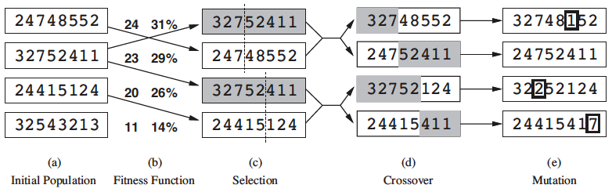
Genetic algorithms

Slide 31
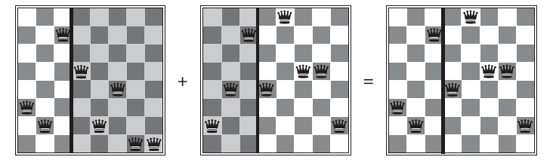
Genetic Algorithms

Slide 32
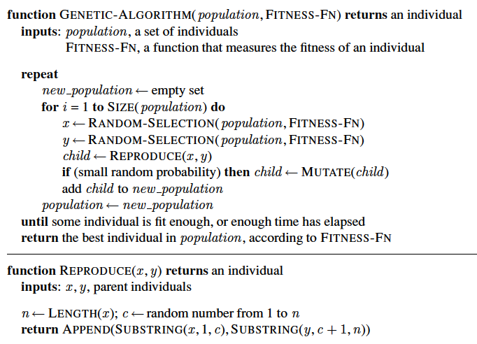
Genetic Algorithms

Slide 33
Thank You!
In our next session:
Particle Swarm, Ant Colony

